Slide 1
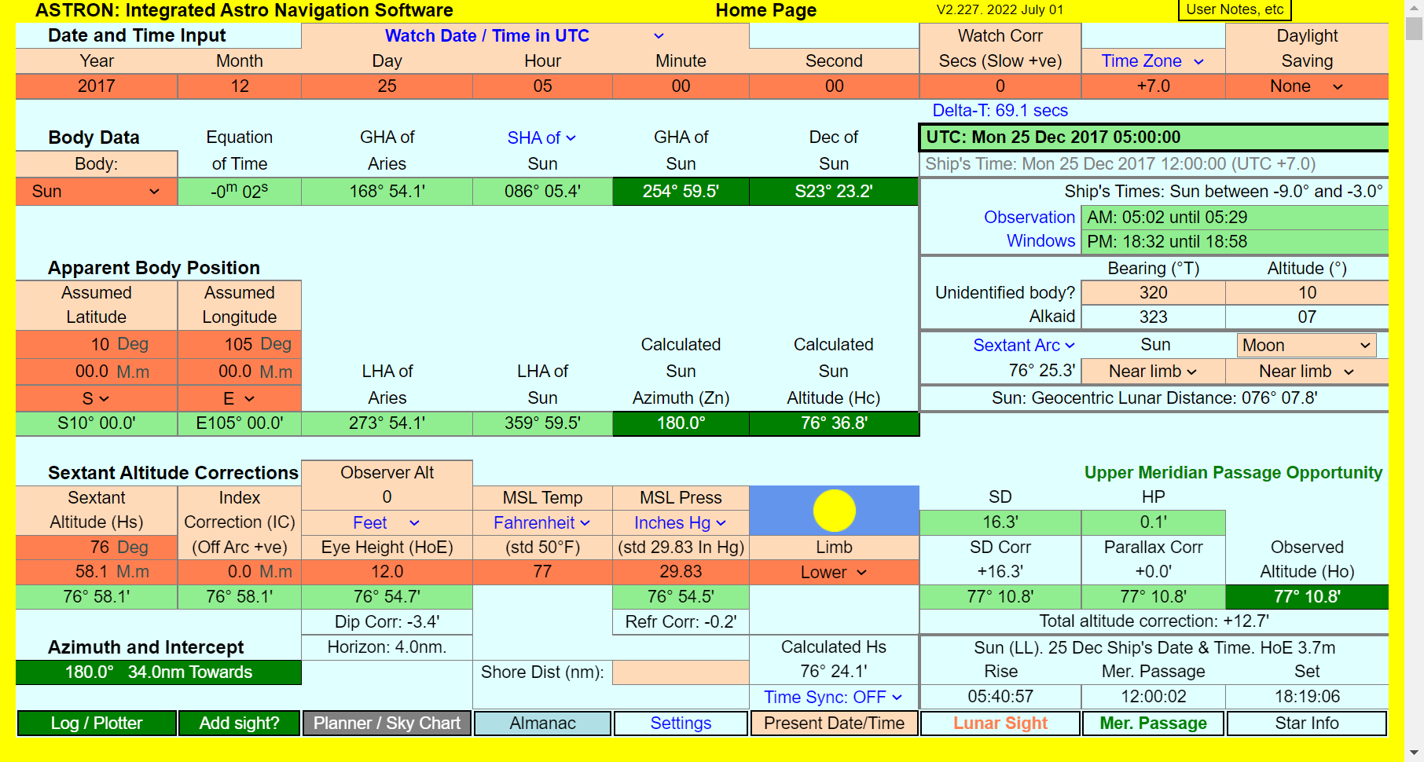
ASTRON V2.227 HOME PAGE
Click here to download the User Notes ▼
Click on one of the above line of tabs to move to a different page
General View of Astron Home Page

Slide 2





Before you start, choose your settings
A: Choose UTC or Ship’s Time
B: Choose Time Zones or Zone Differences
C: Choose Feet or Metres
D: Choose Fahrenheit or Celsius
E: Choose Hectopascals or Inches of Mercury
There are other settings too, both on this page and the Settings page.
All settable items have blue legend and are remembered for your next use.
s

Slide 3
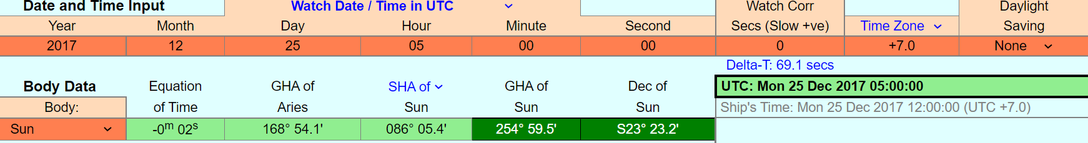
HOME PAGE - ALMANAC SECTION
Insert values into all 9 date/time data entry cells on the top line.
Choose body. (Sun, Moon, 5 planets, 58 stars.)
Data entry cells have background colour.
Result cells, such as GHA and Dec, have DARK GREEN background.
Additional information cells have background.
Semi Diameter, Horizontal Parallax , Rise, Set and Mer Passage times are listed further down the page (not shown on this extract)
The “Equation of Time” cell is only for the Sun.
  For the Moon, it changes to Phase.
  For other bodies, it changes to Magnitude.

Slide 4
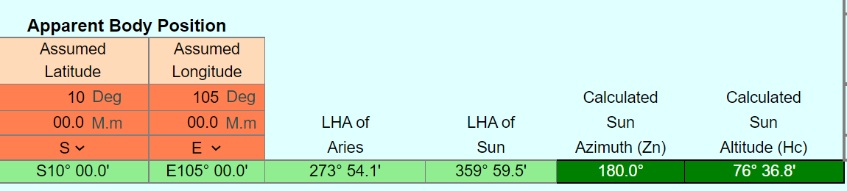
HOME PAGE - APPARENT POSITION SECTION
Now enter Assumed Latitude and Longitude.
Astron calculates the geocentric Azimuth and Altitude
for the entered position and time.

Slide 5
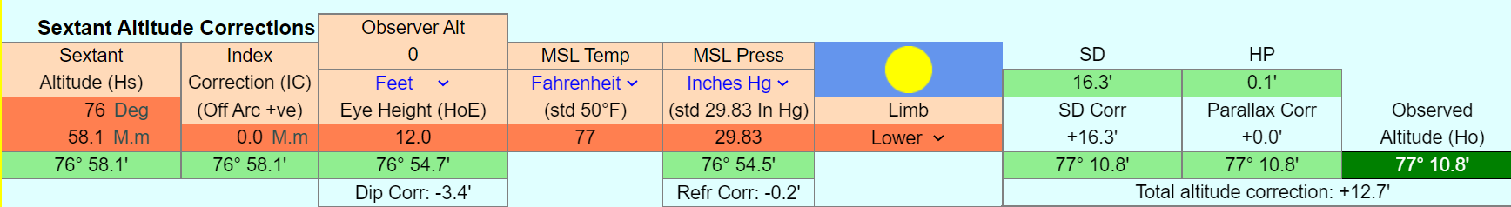
HOME PAGE - SEXTANT ALTITUDE CORRECTIONS SECTION
Now enter values into the above 7 input cells.
Astron corrects your measured sextant altitude (Hs) for index, dip,
refraction, semi-diameter and parallax to give the geocentric
Observed Altitude (Ho) result.
This will differ from the Computed Altitude (Hc) unless your
observation was perfect and your Assumed Position was exact.
The cumulative effect of the corrections is shown in the light green cells below each entry, and the individual
amount of each correction is shown on a plain background.
The sun image here just indicates daylight. The Sun sets and the background progressively darkens with Sun depression below the horizon, indicating degree of darkness. For the Moon and some planets, the image shows the phase in the correct aspect – this is to indicate which limb is illuminated.

Slide 6
HOME PAGE - AZIMUTH and INTERCEPT result
The dark green Azimuth and Intercept results are the difference between
Calculated Altitude and Observed Altitude. You can now plot this as a
conventional Line of Position (LoP).
Alternatively, you can press the “Add Sight” button to add this to the
Sight Log and Sight Plotter which we will explain later.
The other tabs at the bottom of the page are to access other features
of Astron that we will also discuss later.
Please note that this presentation is just an outline. For a full
explanation of any feature of Astron, refer to the User Notes.

Slide 7
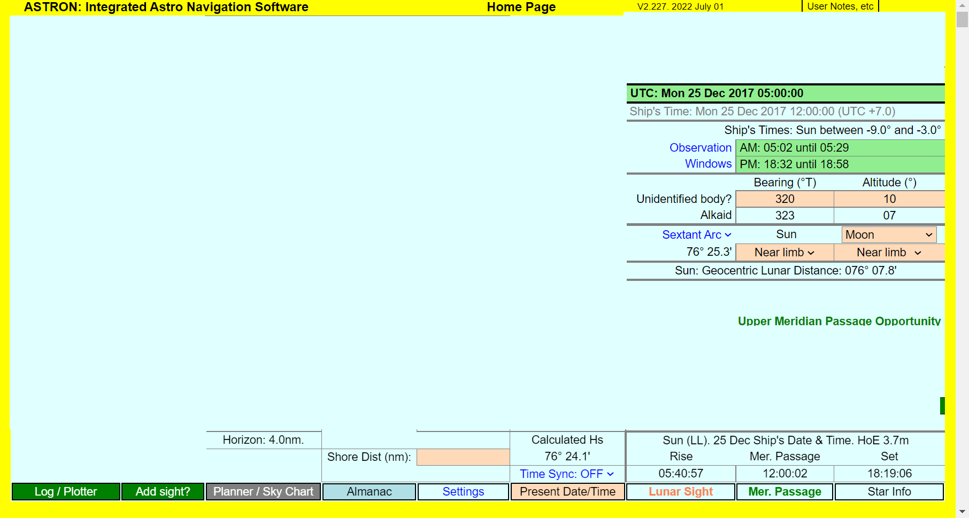










OTHER INFORMATION DISPLAYED ON HOME PAGE. (Lots of it!)
Display of both GMT and Ship’s Time. The selected time input mode is in green.
Dawn and dusk observation windows.
These are always in Ship’s time.
Unidentified Body utility. Enter the approximate
bearing and altitude. Astron shows the nearest
body to this position.
Arc distance facility. Shows the arc distance between the selected body and any other chosen body. Choice of calculated sextant arc or geocentric arc.
The arc distance between the Moon and the selected body
Mer Passage Pop-Up. Indicates that this sight may be suitable for Meridian Passage analysis. (Similar pop-up if suitable for a Lunar Sight.)
Calculated sextant altitude. Useful for pre-setting instrument.
Dip short facility. Enter shore distance here to get correction to Hs.
Distance to horizon for entered eye height
Time sync facility.
Keeps time synchronised with present time. Updates all readouts once every second. Can be advanced or retired by up to 200 seconds from settings page.
Update date/time to present UTC (or ship’s time if selected).
Rise, Meridian Passage and Set times for the selected body. (For entered limb, eye height, etc.)

Slide 8
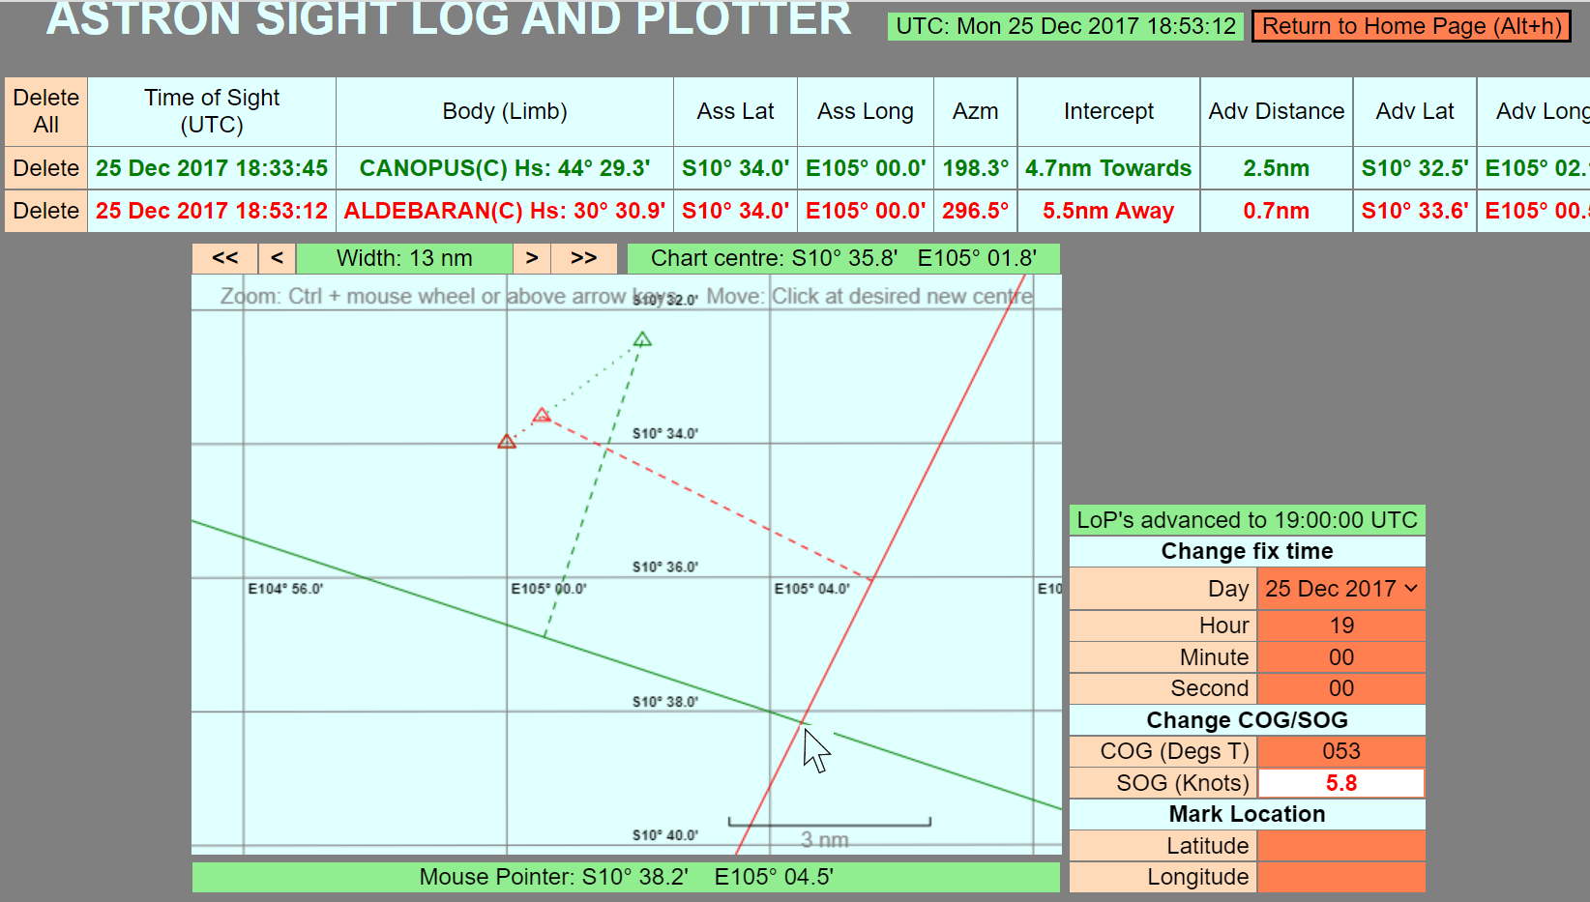


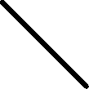


SIGHT LOG and SIGHT PLOTTER
Instructions on how to change scale and chart position
Advanced assumed positions
Wanted fix time
Assumed position
1900 UTC fix
Place cursor over fix and read off position here.
COG / SOG
When working online, this utility can also superimpose this
Information on a Google Map. Such maps show surface
features, but not meridians nor parallels.

Slide 9
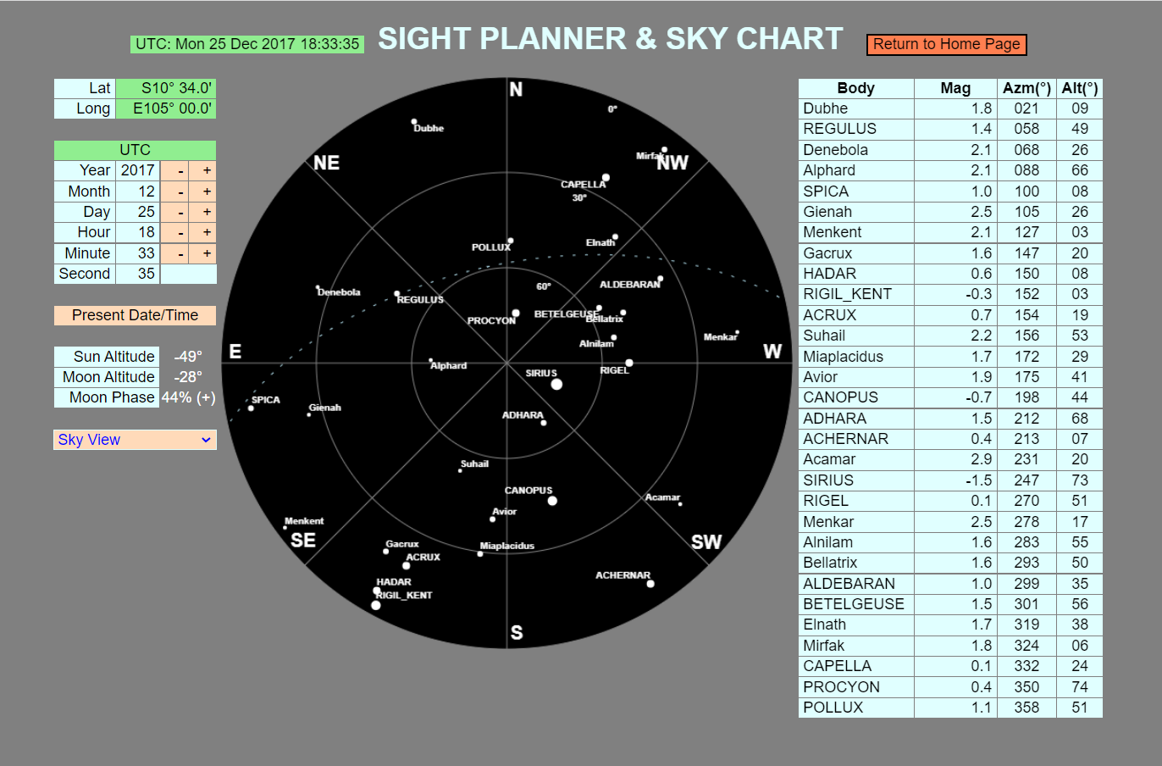

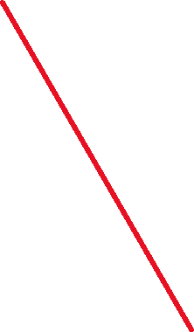
Easy time change box.
Updates home and almanac pages accordingly.
Plan and linear view options also available
Body sizes in arbitrary relation to magnitude
Above horizon bodies only

Slide 10
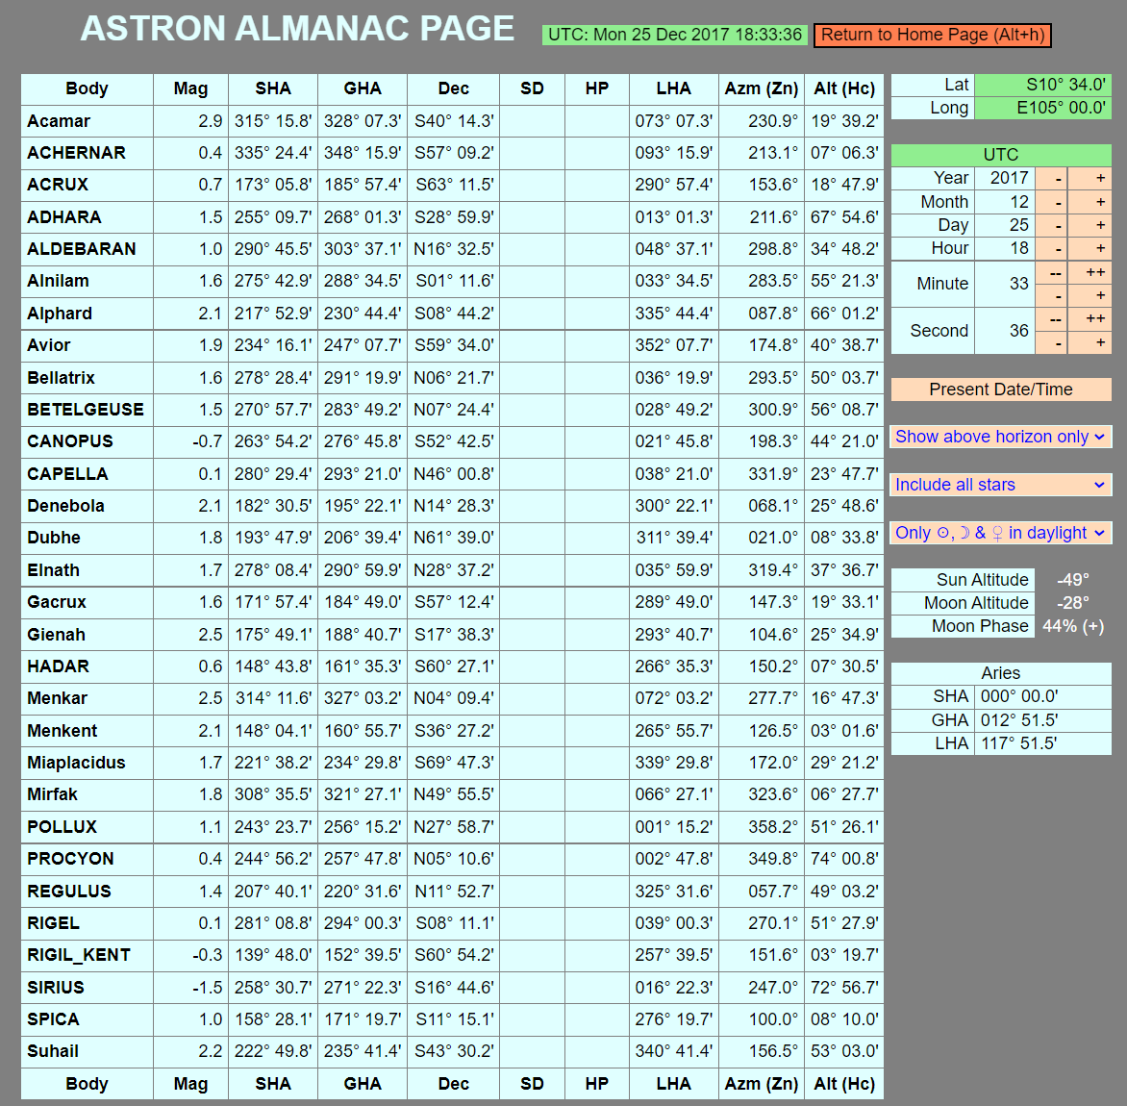
Easy time change box.
Updates home and sight planner pages accordingly.
Various ‘select view’ options
These columns blank as Sun, Moon and planets not in selected view (above horizon only)

Slide 11
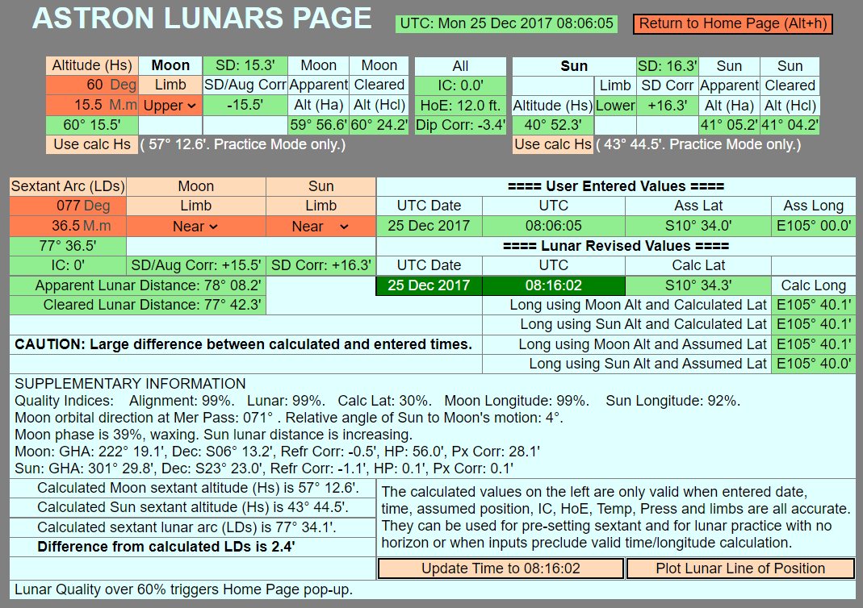
Lunar Sight page. Screenshot of the example in User Notes Chapter 18.
Too much to explain here! Please read User Notes Chapter 18.

Slide 12
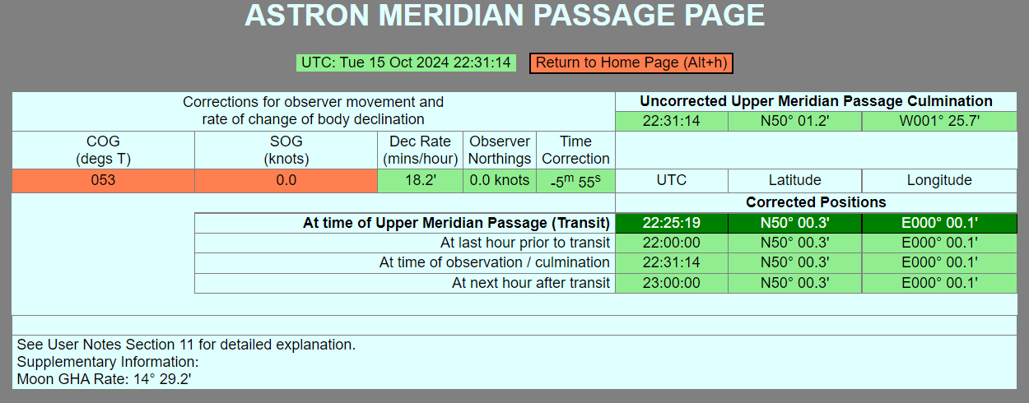
These are all the same position as the vessel is stationary.
Screenshot of the example in User Notes Appendix 7.8.2 on Oct 15th, 2024. This is an extreme example when the Moon’s declination change rate is over 18’ per hour.
If uncorrected, an error of 5m 55s and 1° 25.6’ longitude would occur. Could be greater on a moving vessel – 18 knots Southbound would double the effect!
Please read User Notes Chapter 11.

Slide 13

Thank you for viewing this outline presentation.
The author hopes that you find Astron useful.
Please note that this presentation is seldom updated and may differ in small respects from the version of Astron dated 2022 July 01 that has been used here.
Please read User Notes for full details of Astron.

